Slide 1


REAL TIME TRAFFIC MANAGEMENT
AND
AIR QUALITY MONITORING SYSTEM
USING IOT

Slide 2
Problem Statement
The proposal is titled “REAL TIME TRAFFIC MANAGEMENT AND AIR QUALITY MONITORING SYSTEM USING IOT” and the goal of the project to simplify and optimize the existing traffic management system by making it a SMART process. Aim is to analyse the traffic present on traffic signals and monitor the contamination in the air. As per the analysis results, the time of the traffic signals will adjust themselves dynamically.

Slide 3
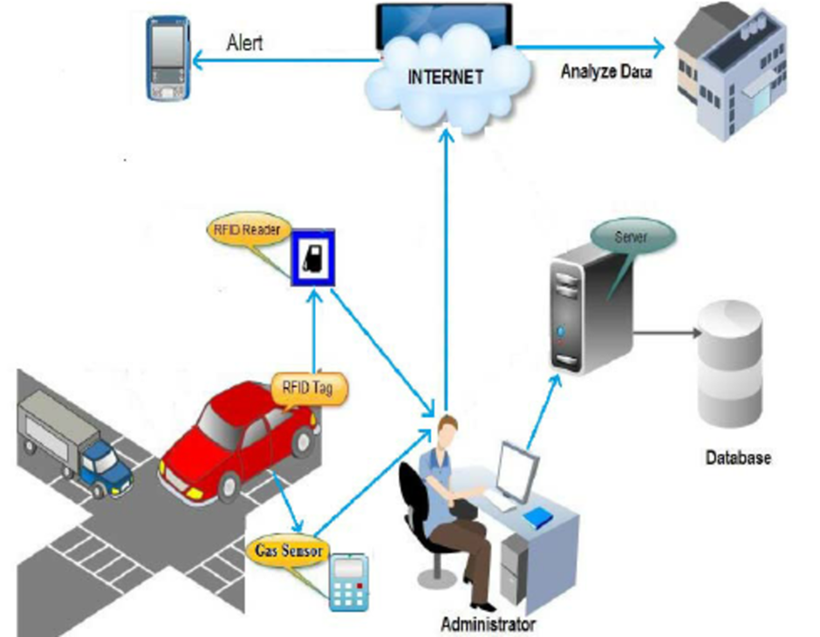
Architecture

Slide 4
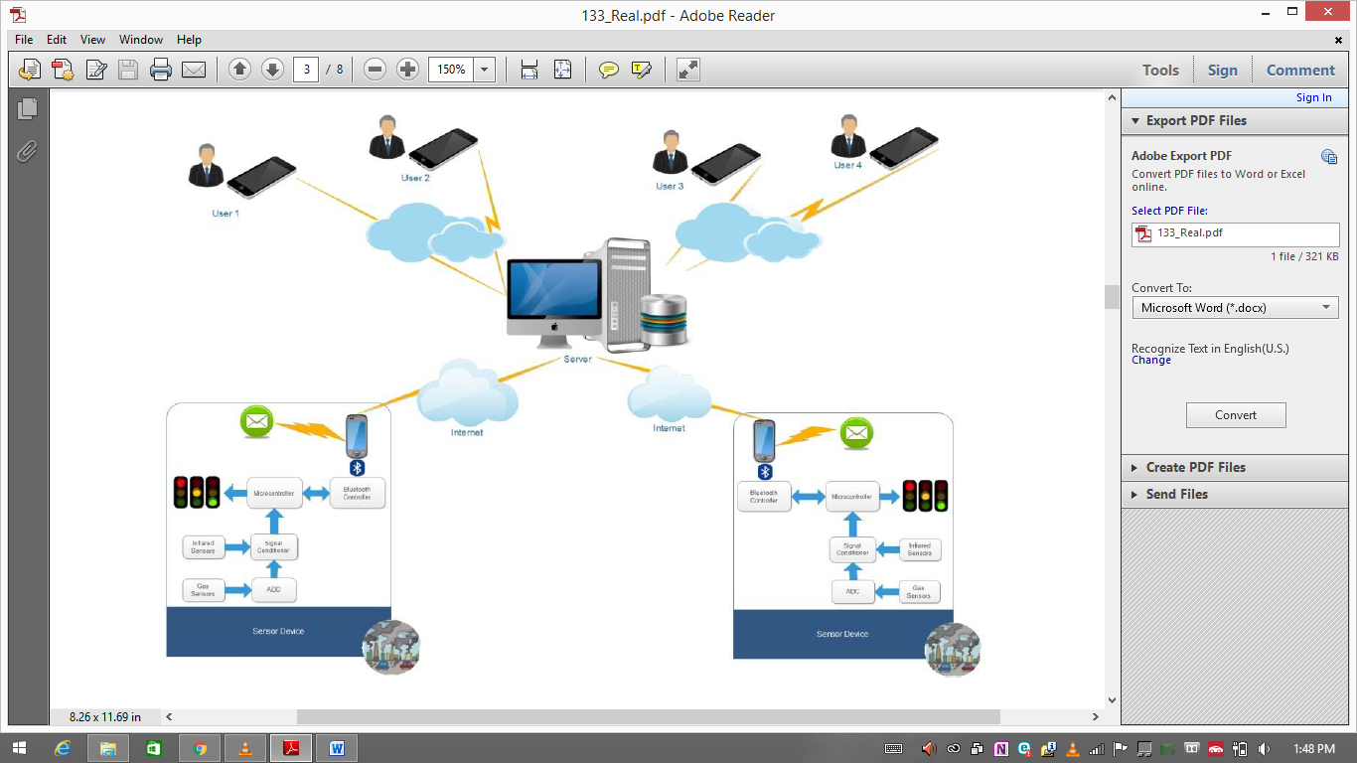
Internal Structure

Slide 5
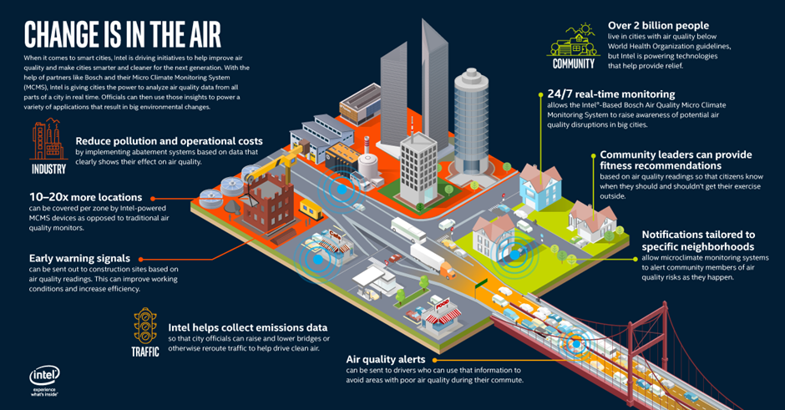

Slide 6
Why it’s better than existing solutions
The current system involves a fixed time duration for every traffic signal. It has been observed that some sides of a roundabout or some roads of the city experience heavier traffic compared to others. This leads to traffic jams, road blocks and high levels of air pollution in that particular area. Also, due to the fixed time intervals of green, orange and red signals the waiting time is more and vehicles use more fuel.

Slide 7




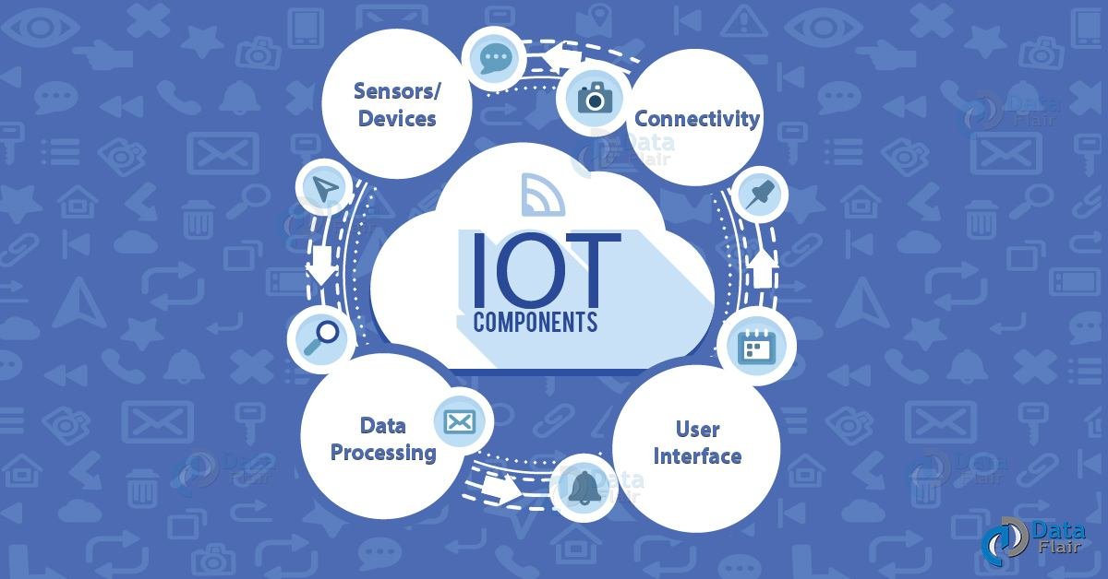
Dependencies

Slide 8
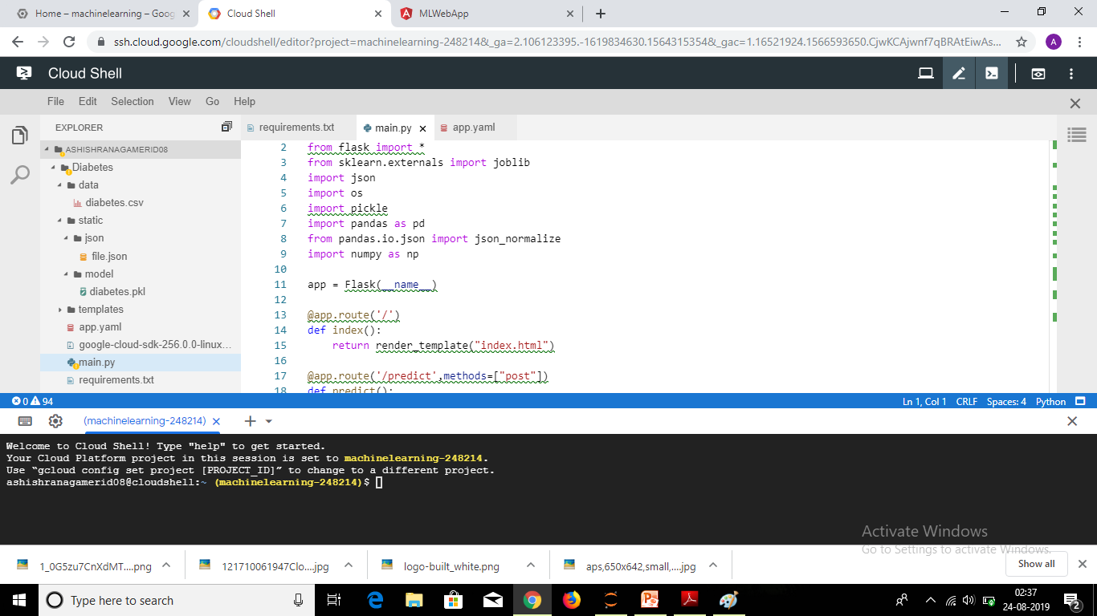

Slide 9
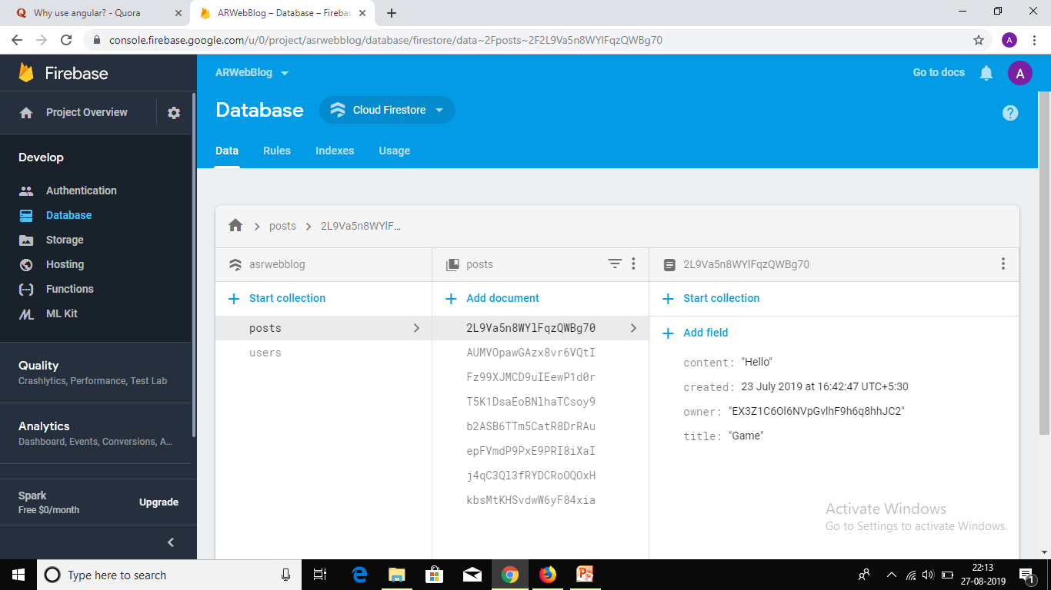

Slide 10
Why Angular ?
Perfect implementation of Model View Controller (MVC) architecture
Uses Plain Old JavaScript Objects (POJO) data, models
Directives that quickly enhance functionality
Less coding
Easy to use filters
Edge with modules and simplified testing
Parallel development and code reusability
Security

Slide 11
Questions?

Slide 12
Thank you…

